Slide 1

Linear Models Random Forests Model Evaluation
Gerrit Gruben

Slide 2
Outlook
In this module you will learn about,
Decision tree based models, what they are and how to use them, incl.
Decision Trees
Random Forests
Gradient Boosted Trees
Understand the setting of supervised learning and how to solve problems with them.
Get the problem of overfitting and techniques to spot and deal with it.

Slide 3
Supervised Learning
… and the problem of overfitting.

Slide 4
Source: All Programming Tutorials

Slide 5
Supervised Learning (Mathematical)
Given from a joint distribution on X and Y:
training samples x₁, …, x_{n} (independent variables, features)
accompanying labels y₁,…,y_{n} (dependent variables)
Find a model f: X → Y, s. t. given only a x from this distribution, f(x) is the "best" guess. Interpretations:
Function Approximation: There is a relation y = f(x) + ε, with ε noise, and we want to estimate f.
Probabilistic: We model p(y | x), with the relation p(x, y) = p(y | x) p(x). The "perfect" model would be argmax_{y}p(y | x), i.e. the mode of the distributions p(y | x₀) for fixed x₀. This is the MAP (maximum a posteriori) estimate (we add training set to the conditional set).

Slide 6
Classification / Regression
Classification: Y discrete
#Y = 2: binary classification,
#Y > 2: multiclass classification,
If classes are not mutually exclusive: multi-label classification (best seen as multiple output model)
Regression: Y real

Slide 7
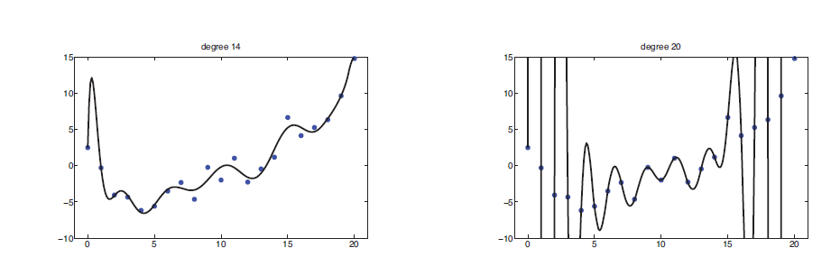
Overfitting
Overfitting = overly complex model learns noise. (aka. Bias-variances tradeoff)

Slide 8
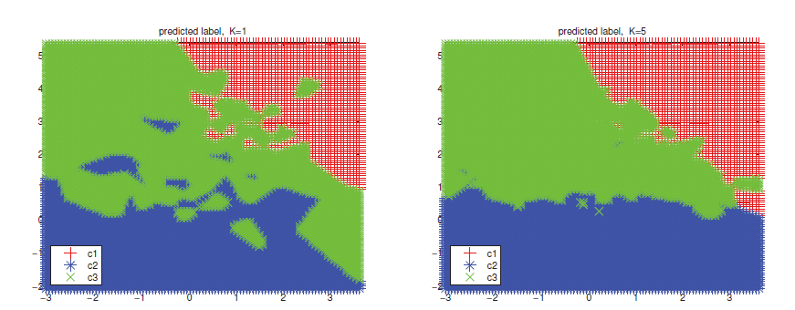
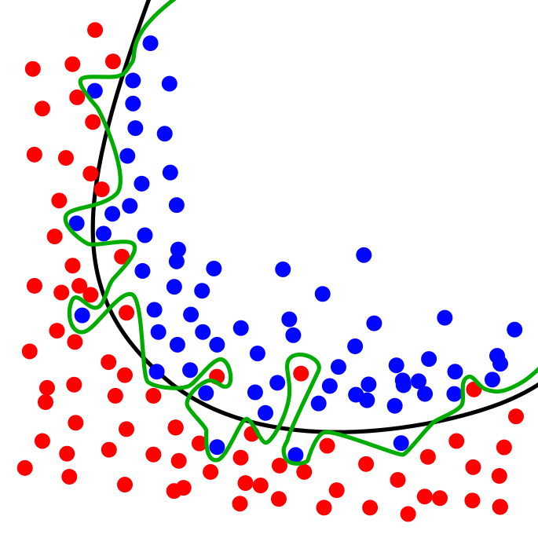
Overfitting Surfaces

Slide 9
Linear Models
Linear regression, logistic regression, L1 & L2 regularization

Slide 10
Linear Models
Linear models are a power horse, esp. with non-linear features.
Robust, well-understood, works on big data (if you do not overdo feature extraction).
Requires one-hot encoding of categorical features, numerical ones should be Z-normalized to make regularization work well.
Other trick: to make linear models affine (i.e. add a constant bias), extend each data row by a one.

Slide 11
import sklearn.preprocessing as pp
# One-hot encoding
oh_enc = pp.OneHotEncoder(
n_values="auto", # num. of. cats
# which columns are categorical?
categorical_features="all",
sparse=True # hold as sparse?
)
oh_enc.fit(some_data)
oh_enc.transform(some_data)
# optionally: to_array() to go back from sparse representation
# it's always fit/transform
# Label encoding
le = pp.LabelEncoder()
le.fit([1, 2, 2, 6])
# also fit_transform
# le.classes_ == array([1, 2, 6])
le.transform([1, 2, 2, 6])
# == array([0, 0, 1, 2])
# Trick with Pandas
from collections import defaultdict
d = defaultdict(pp.LabelEncoder)
fit = df.apply(lambda x: d[x.name].fit_transform(x))
df_new.apply(lambda x: d[x.name].transform(x))

Slide 12
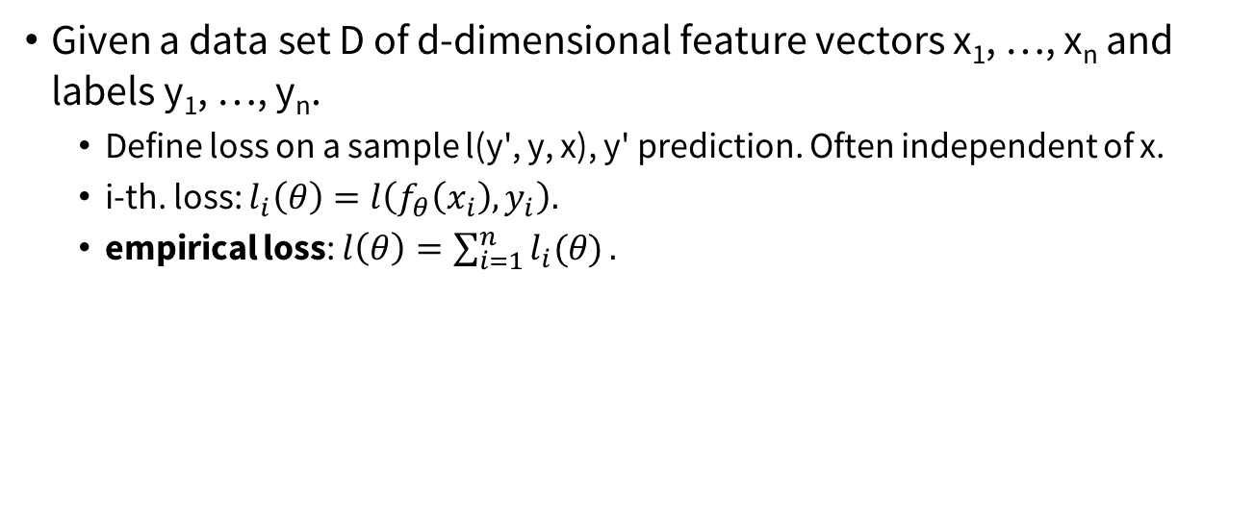
Empirical loss
Given a data set D of d-dimensional feature vectors x₁, …, x_{n} and labels y₁, …, y_{n}.
Define loss on a sample l(y', y, x), y' prediction. Often independent of x.
i-th. loss: $l_{i}\left(θ\right)=l\left(f_{θ}\left(x_{i}\right), y_{i}\right).$
empirical loss: $l\left(θ\right)=\sum_{i=1}^{n}{l_{i}(θ)}.$

Slide 13
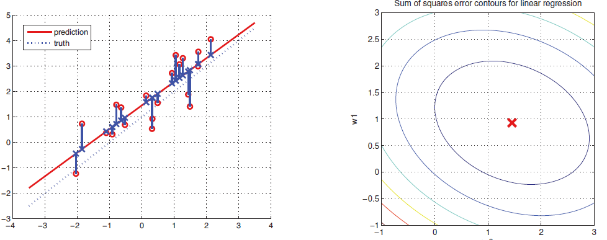
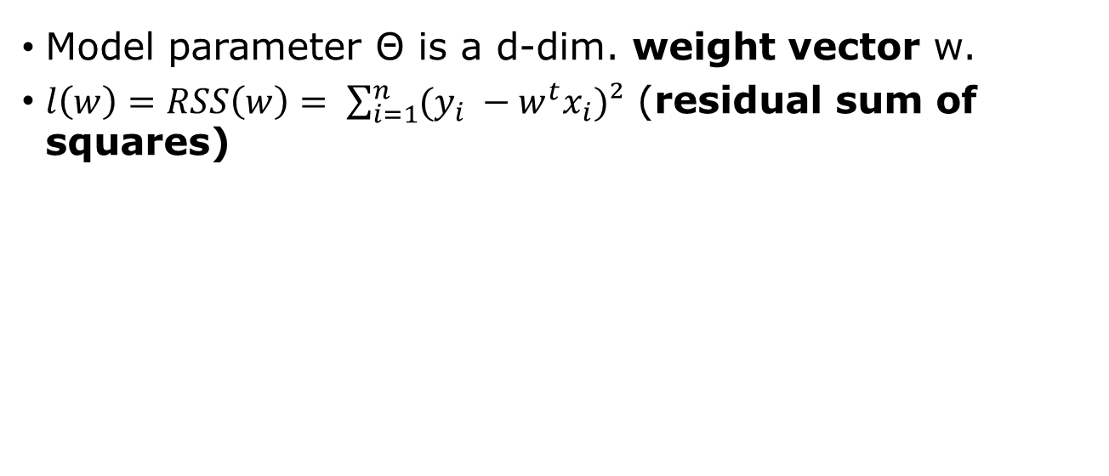
Least Squares
Model parameter Θ is a d-dim. weight vector w.
$l\left(w\right)=RSS\left(w\right)= \sum_{i=1}^{n}{(y_{i} −w^{t}x_{i})²}$ (residual sum of squares)

Slide 14
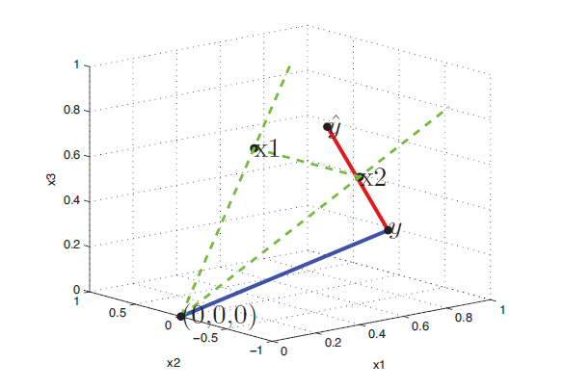
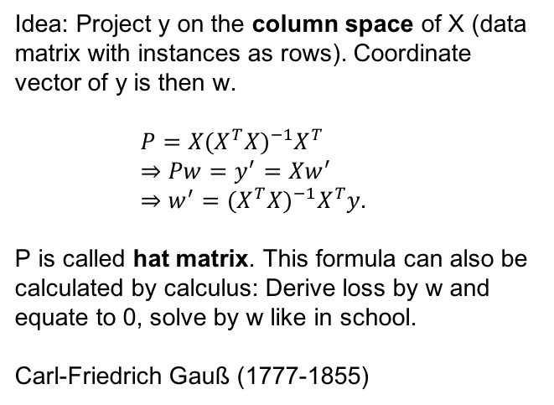
Geometric Proof (N >= D)
Idea: Project y on the column space of X (data matrix with instances as rows). Coordinate vector of y is then w.
$P=X{{(X}^{T}X)}^{−1}X^{T}$
$⇒Pw=y^{′}=Xw^{′}$ $⇒w^{′}=$ ${{(X}^{T}X)}^{−1}X^{T}y$.
P is called hat matrix. This formula can also be calculated by calculus: Derive loss by w and equate to 0, solve by w like in school.
Carl-Friedrich Gauß (1777-1855)

Slide 15
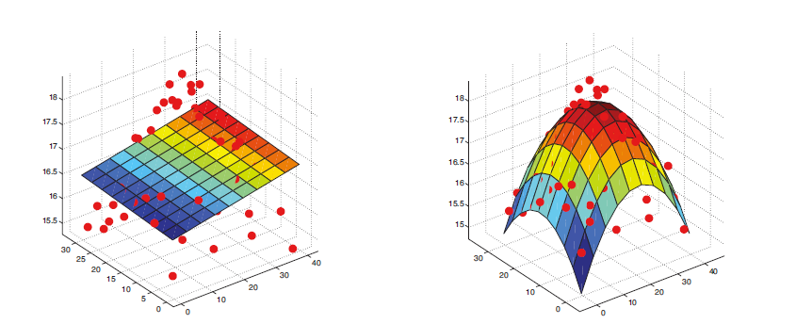
Polynomial feats on remote sensing data

Slide 16
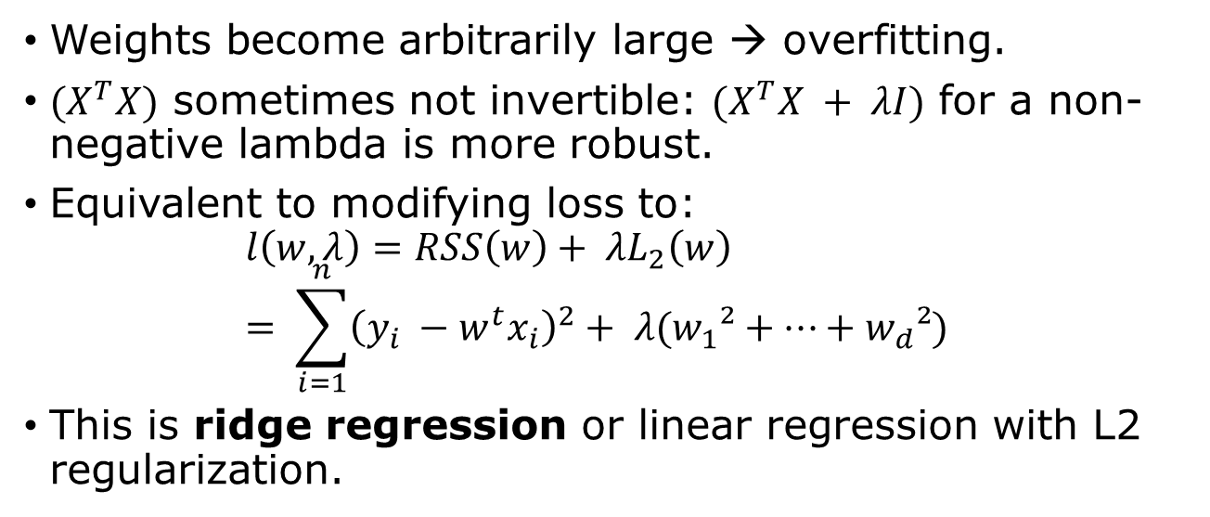
Problems with Least Squares
Weights become arbitrarily large → overfitting.
${(X}^{T}X)$ sometimes not invertible: ${(X}^{T}X + λI)$ for a non-negative lambda is more robust.
Equivalent to modifying loss to: $l\left(w, λ\right)=RSS\left(w\right)+ {λL}_{2}\left(w\right)= \sum_{i=1}^{n}{{\left(y_{i} −w^{t}x_{i}\right)}^{2}}+ λ(w_{1}²+…+w_{d}²)$
This is ridge regression or linear regression with L2 regularization.

Slide 17
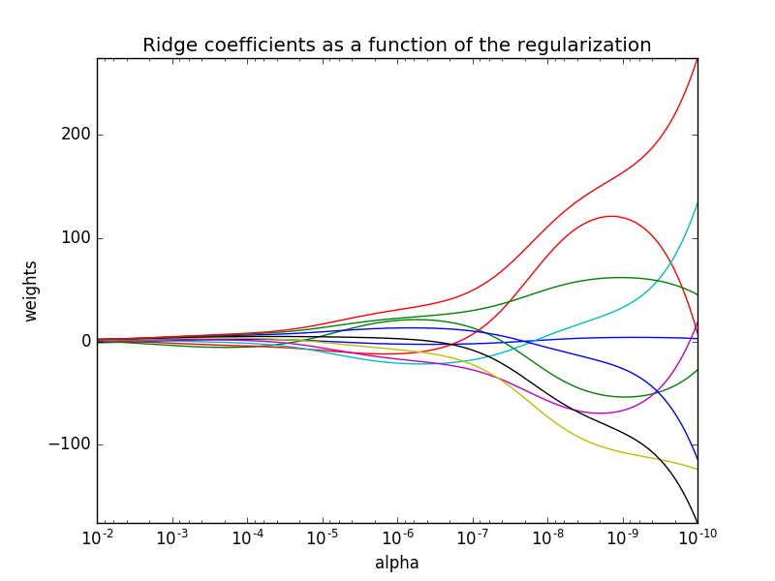
Lambda / Weights

Slide 18
Lambda
Lambda is a hyper parameter.
Chosen on a log-scale (try …0.05, 0.1, 0.5, 1, 5, …).
The smaller the lambda, the larger the weights can get and the model can become more complex.
More data → smaller lambda.
If you add more features → larger lambda. But that depends on the precise feature added and how it correlates to the target variable.

Slide 19
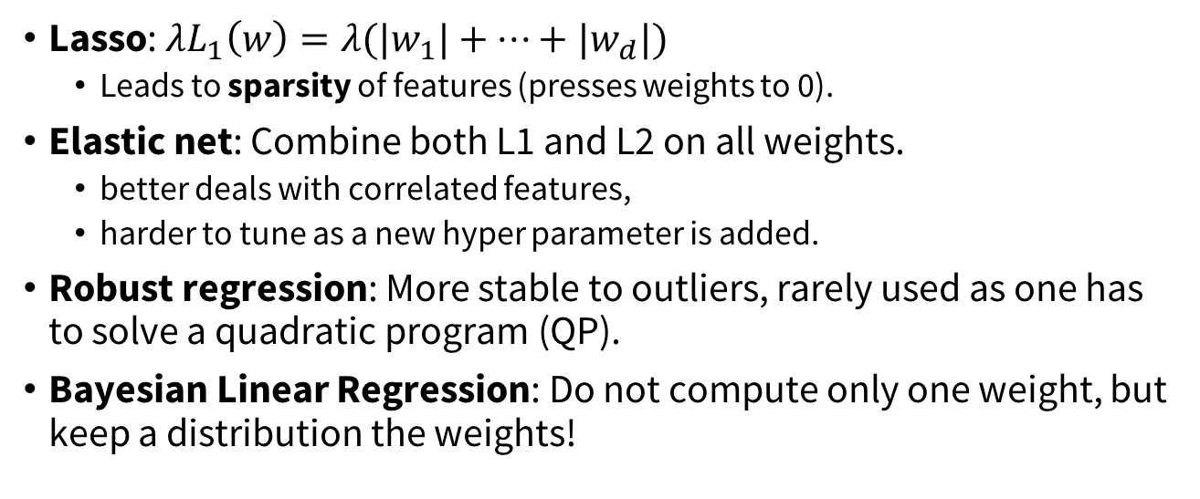
Other variants
Lasso: ${λL}_{1}\left(w\right)=λ(|w_{1}|+…+|w_{d}|)$
Leads to sparsity of features (presses weights to 0).
Elastic net: Combine both L1 and L2 on all weights.
better deals with correlated features,
harder to tune as a new hyper parameter is added.
Robust regression: More stable to outliers, rarely used as one has to solve a quadratic program (QP).
Bayesian Linear Regression: Do not compute only one weight, but keep a distribution the weights!

Slide 20
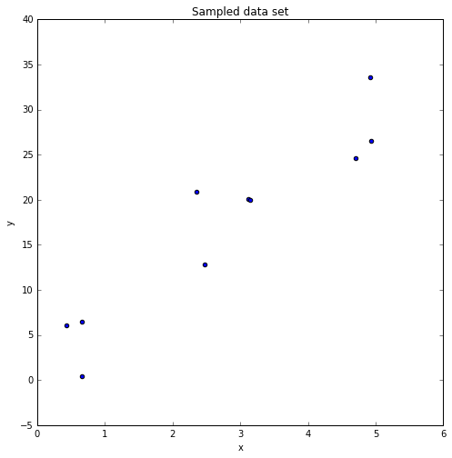
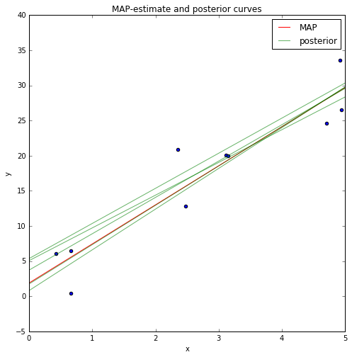
Bayesian Linear Regression example

Slide 21
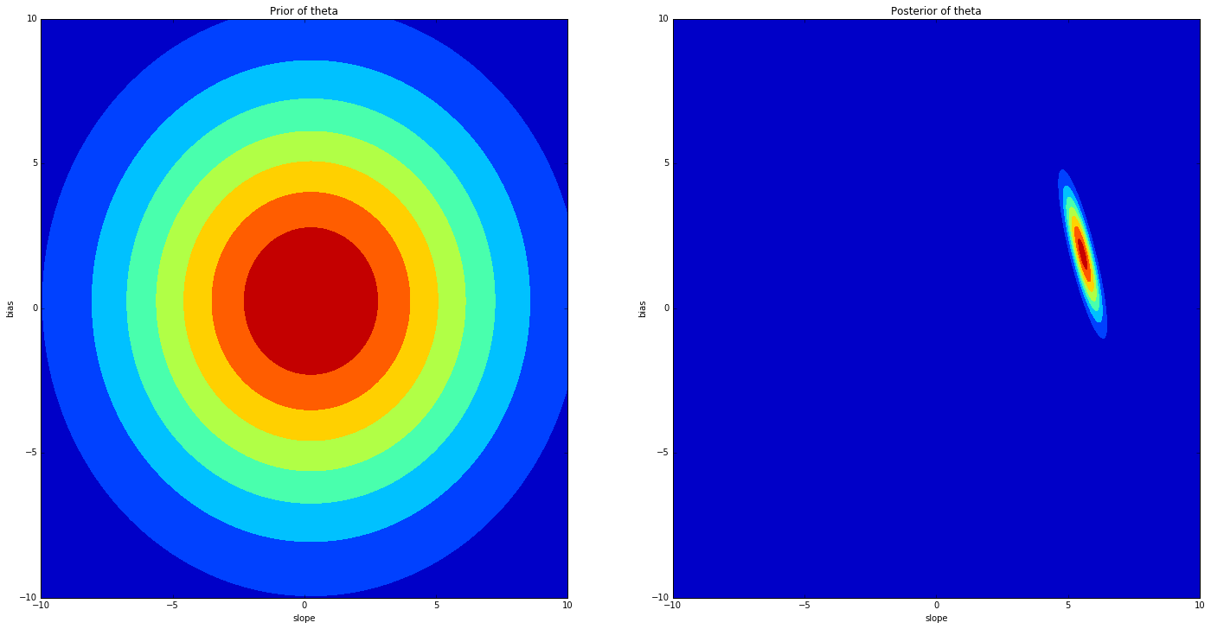

Slide 22
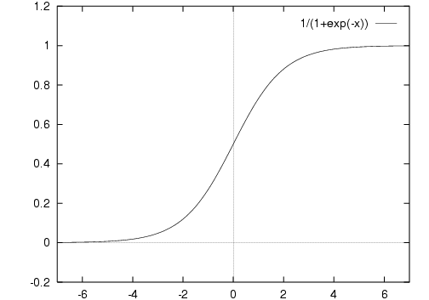
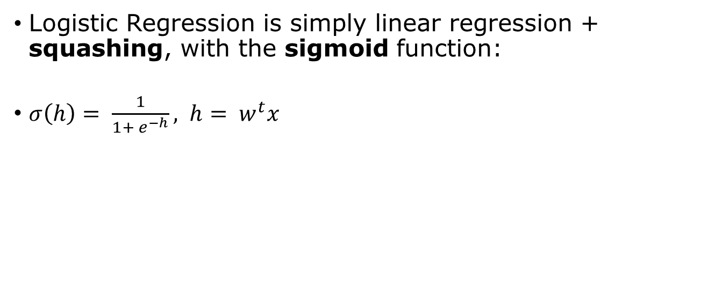
Logistic Regression
Logistic Regression is simply linear regression + squashing, with the sigmoid function:
$σ\left(h\right)= \frac{1}{1+ e^{−h}}, h= w^{t}x$

Slide 23
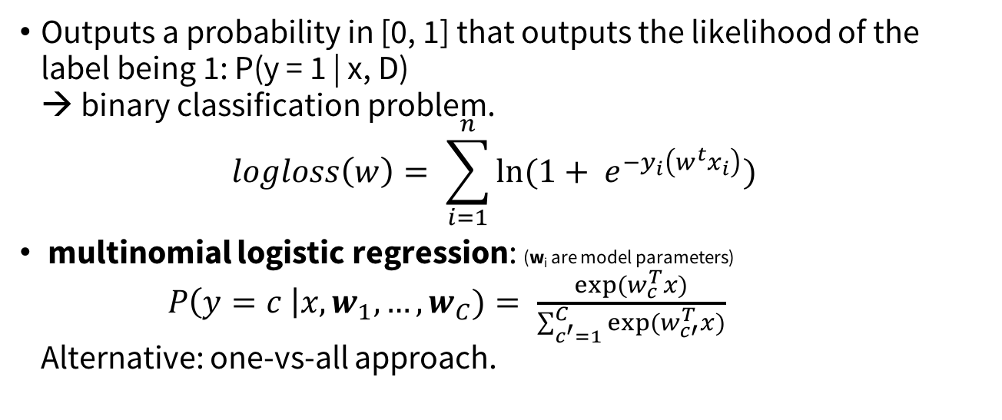
Logistic Regression II
Outputs a probability in [0, 1] that outputs the likelihood of the label being 1: P(y = 1 | x, D) → binary classification problem. $logloss\left(w\right)= \sum_{i=1}^{n}{ln⁡(1+ e^{−y_{i}\left(w^{t}x_{i}\right)})}$
multinomial logistic regression: (w_{i} are model parameters) $P\left(y=c \right|x, w_{1}, …,w_{C})= \frac{exp⁡(w_{c}^{T}x)}{\sum_{c^{′}=1}^{C}{exp⁡(w_{c′}^{T}x)}}$ Alternative: one-vs-all approach.

Slide 24
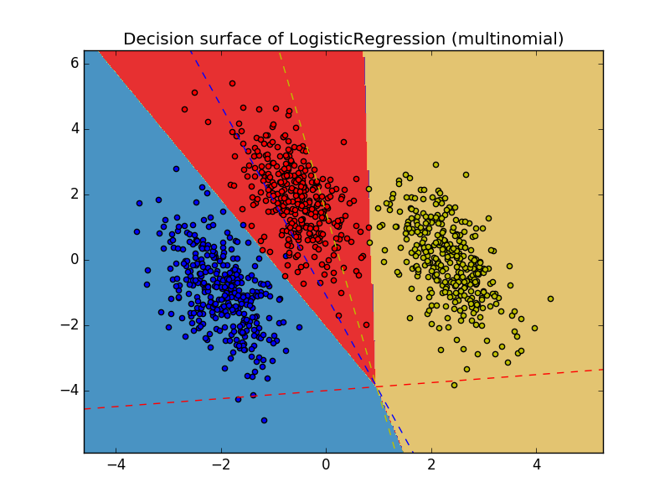
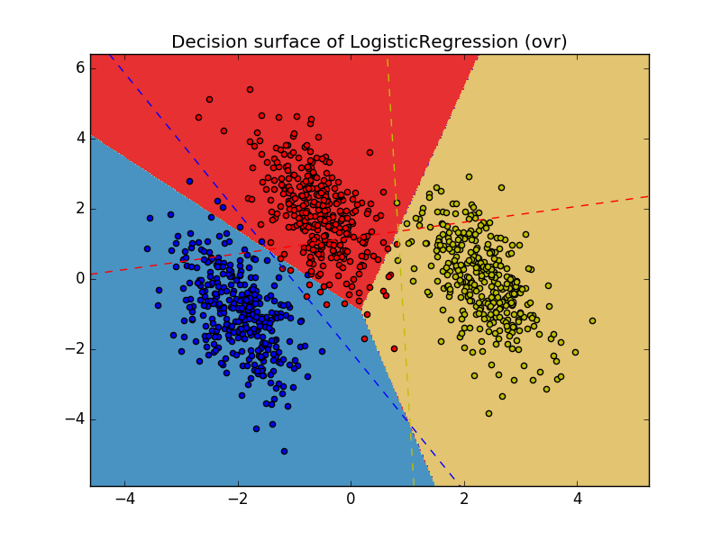
Multinomial vs One-vs-rest

Slide 25
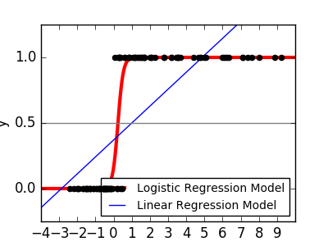
Logistic Regression III

Slide 26
Linear Regression sklearn
Logistic Regression sklearn
from sklearn.linear_model
import Ridge
l2_reg = Ridge(alpha=0.5) # lambda l2.fit(X, y)
y_pred = l2.predict(X_train)
l2._coef # returns w
l2._intercept # returns constant
from sklearn.linear_model import LogisticRegression
lr_clf = LogisticRegression(
penalty="l2", # or "l1"
C=1./lambda, # capacity
fit_intercept=true, # add bias?
n_jobs=-1) # -1 = all cores
lr_clf.fit(X_train, y_train)
y_pred = lr_clf.predict_proba(X_test)

Slide 27
Decision Trees

Slide 28
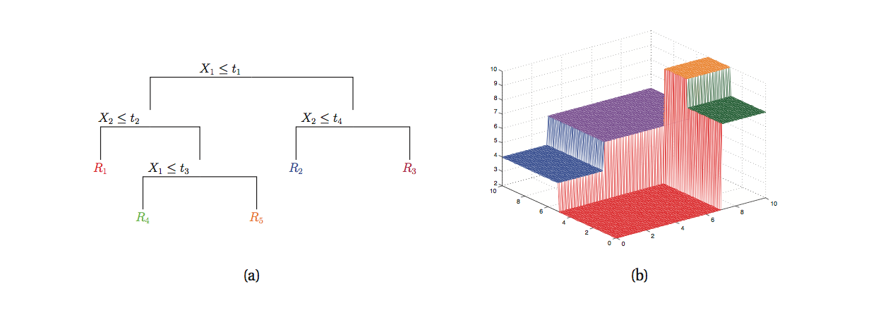

Slide 29
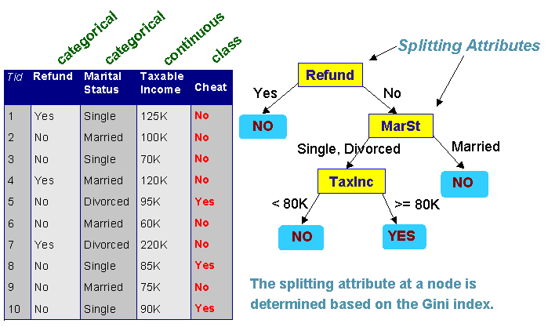
Basic Idea
Use a tree in which inner nodes split the data into two branches and terminal leafs contain a result.
Split is taken to be the one that carries “maximal” information gain.
Measured in entropy or gini.

Slide 30
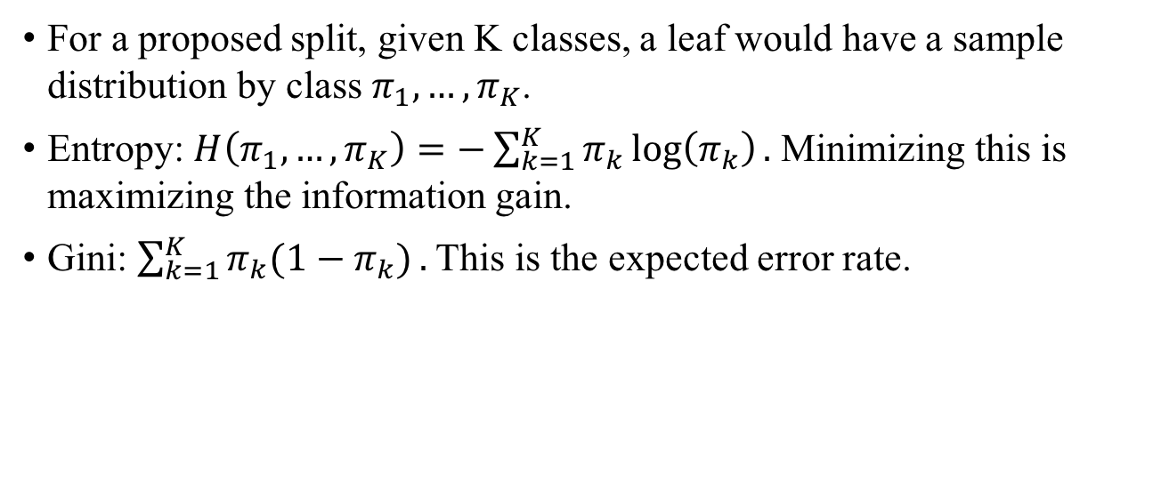
Split Criterias
For a proposed split, given K classes, a leaf would have a sample distribution by class $π_{1}, …, π_{K}$.
Entropy: $H\left(π_{1}, …, π_{K}\right)=−\sum_{k=1}^{K}{π_{k}}\log\left(π_{k}\right).$ Minimizing this is maximizing the information gain.
Gini: $\sum_{k=1}^{K}{π_{k}(1−π_{k})}.$ This is the expected error rate.

Slide 31
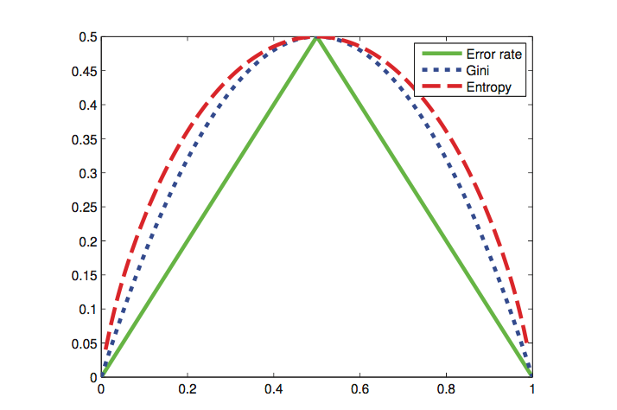

Slide 32
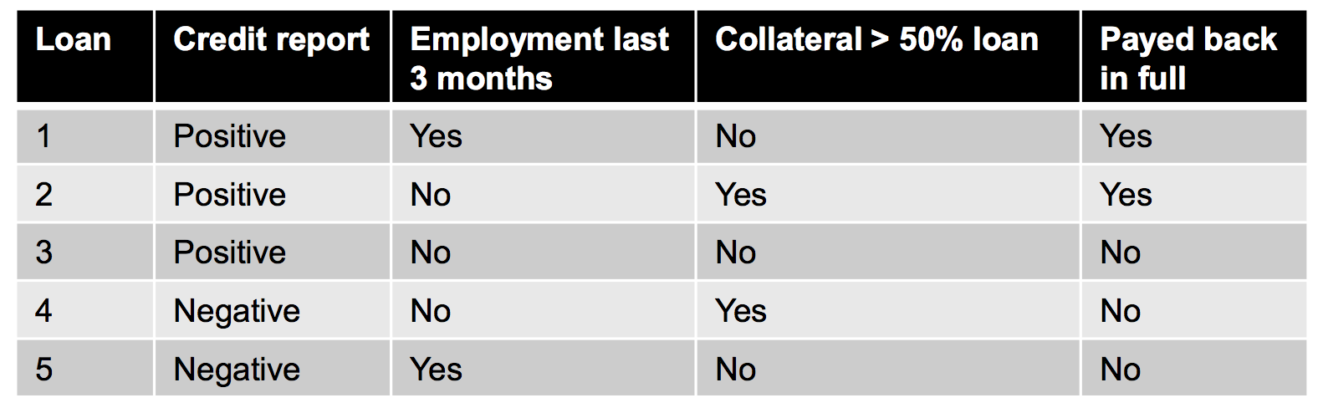
Example

Slide 33
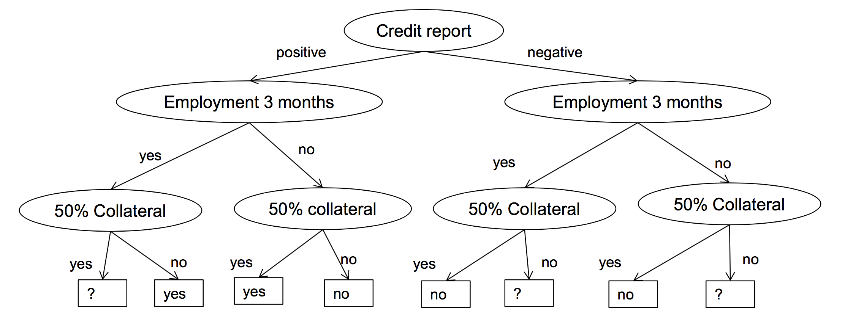
Example

Slide 34
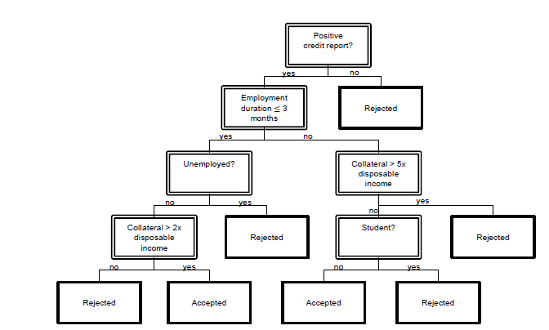
Decision Trees - Algorithms
Usually trained by CART (Breiman, 1984) or C4.5/ID3 (Quinlan, 1993/1986).
Optimal Split problem is NP-complete.

Slide 35
Decision Trees II
Every leaf has data points that supports it.
sklearn.tree.DecisionTreeClassifier
criterion: "gini" / "entropy" (kind of information)
max_features: how many features to consider at split
can be integer or ratio (float), other: "auto", "sqrt", "log2", None = all
lower values to speed up, possibly avoids overfitting (unlikely)
max_depth: limits depth of tree (deep = complex = overfitting), None → unlimited expansion.
min_samples_split / leaf: minimum support for split / at leaf.
low number could lead to overfitting.
min_impurity_split: min. impurity to split.
class_weight: weight classes for splitting, "balanced": balances imbalanced classes out (usually a good thing).

Slide 36
Decision Tree III
Decision trees are famous for overfitting.
Long lost trick: Set min_samples_leaf "high" and train models for each leaf, in other words: the decision tree pre-partitions the data set roughly, then more computation intensive / better models do the rest.
High explainability.
Got popular because of ensembling / boosting.

Slide 37
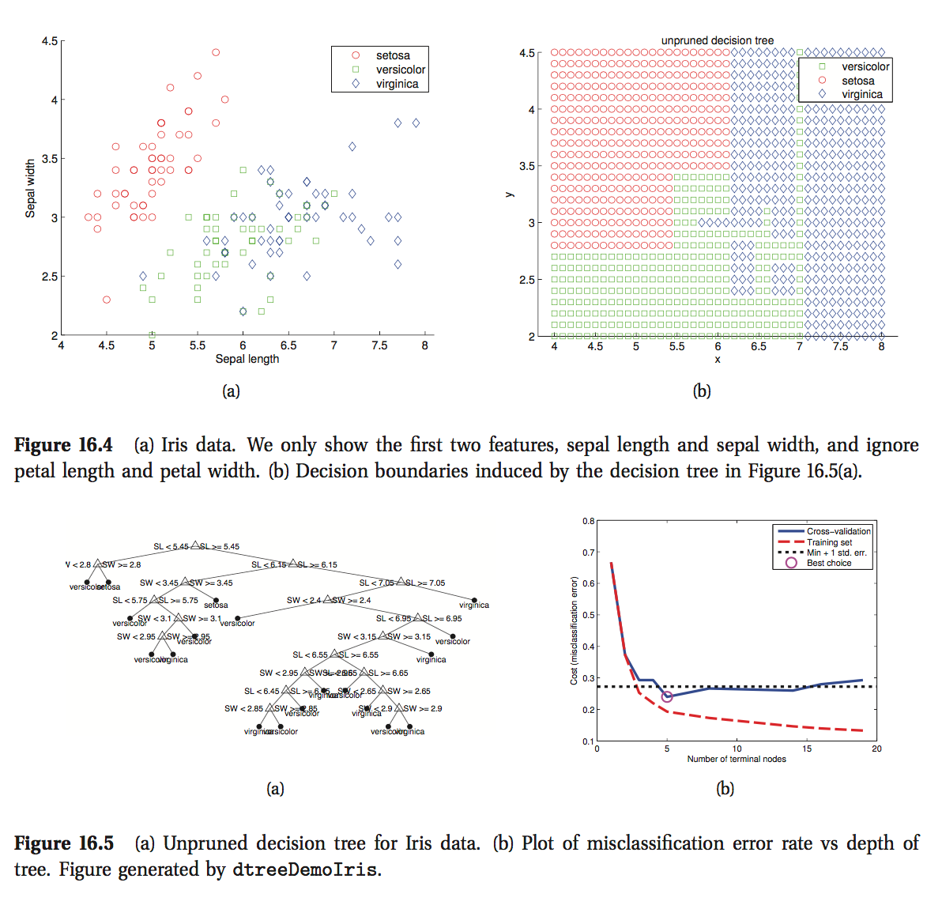
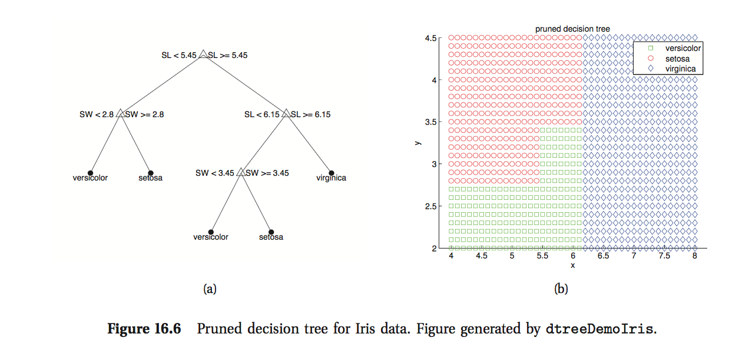
Pruning
Pruning

Slide 38
CART models
Pros
Cons
Easy to interpret
Handle mixed discrete & continuous input, robust to monotone transformations
Automatic variable selection
Robust to outliers
Scales well to large data
Overfitting deluxe (high variance estimators)
Not useful for online learning (unstable to data changes)
Often weaker compared to other models

Slide 39
Random Forests
Ensembles, Bagging, Independence…

Slide 40
Random Forests
Ensemble of decision trees.
Bagging used to fit the trees.
Random Subspace training on a feature subset.
Independence of the training process of each tree.

Slide 41
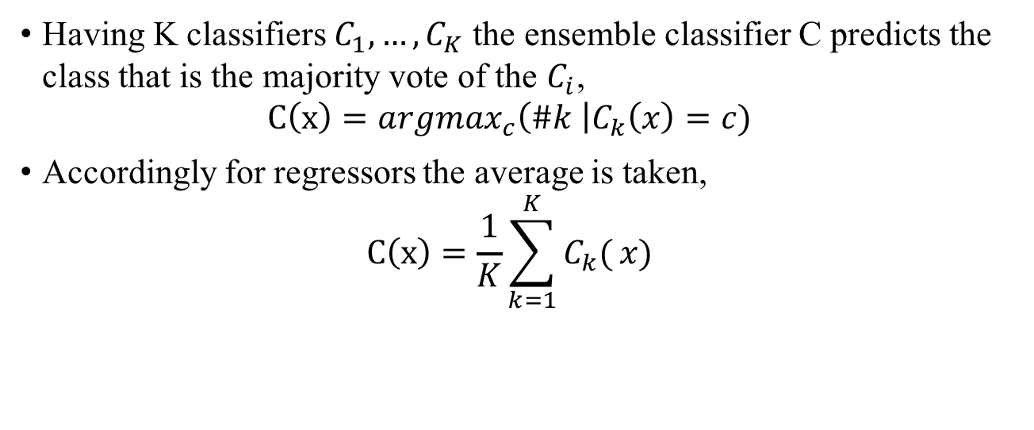
Ensemble
Having K classifiers $C_{1}, …,C_{K}$ the ensemble classifier C predicts the class that is the majority vote of the $C_{i}$, $C\left(x\right)={argmax}_{c}\left(\#k \right|C_{k}\left(x\right)=c)$
Accordingly for regressors the average is taken, $C\left(x\right)=\frac{1}{K}\sum_{k=1}^{K}{C_{k}(}x)$

Slide 42
Bagging (Bootstrap Aggregation)
The idea of bagging is to fit a model on only a subset B of the training data D, the bag.
This is combined with ensembling in RFs.
Other advantage: Can compute error metric on D – B, the out-of-bag error.
Disadvantage: Highly correlated base models.

Slide 43
Random Subset / Independence
For further decorrelation only a random subset of the features can be used, this also speeds up the training process.
In an ensemble the base models can – and should – be trained independently. => Parallelization possible.

Slide 44
Variants
ExtraTrees (in sklearn.tree and sklearn.ensemble): Only a subset of features is used at each node split.

Slide 45
Boosting

Slide 46
Boosting
Boosting: Using a weak base classifier by building a strong one by ensembling successively.
Example: AdaBoost with Decision Stumps (DTs of depth 1).
On step $m$ we have model $F_{m}$ and ideally want to have for each (x,y): $F_{m+1}\left(x\right)= F_{m}\left(x\right)+h\left(x\right)=y$ Thus we optimize $h\left(x\right)=y − F_{m}\left(x\right)$. This is Gradient Boosting.

Slide 47
Evaluation
ERM, Experimental Design, Bias/Variance, CV

Slide 48
Empirical Risk Minimization
Two assumptions:
Data follows a distribution $p(x, y)$ on $X × Y$.
Learner sees data set $D=\{\left(x_{1}, y_{1}\right), …, (x_{N}, y_{N})\}$ of independent and identically sampled (from $p$) data (IID assumption).
The IID assumption is almost always broken in practice.
Notes:
IID is broken because of the data gathering or the way you split your data into datasets.

Slide 49
Empirical Loss
Given a loss function $l$the empirical loss/risk is, $R_{D}\left[f\right]= \sum_{n=1}^{N}{l\left(f\left(x_{n}\right),y_{n},x_{n}\right).}$
This is a statistical estimator if you vary the selection of $D$.

Slide 50
Empirical Risk Minimization II
$R_{D}\left[f\right]$ is supposed to estimate the generalization error/risk, $R\left[f\right]= \int{l\left(f\left(x\right), y, x\right)dp(x, y)}.$
The larger $\left|D\right|$ the more accurate.
$R_{D}\left[f\right]$ has a bias (distance to R$\left[f\right]$) and a variance.

Slide 51
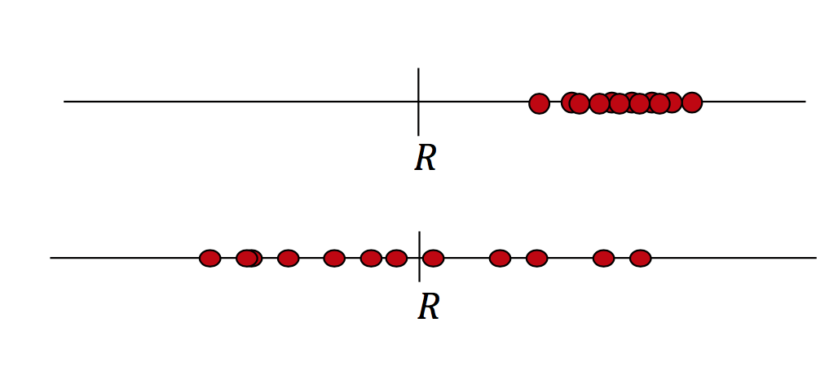
Bias / Variance

Slide 52
Model fitting: finding the best model parameter: $θ={argmin}_{θ}R_{D}[f_{θ}]$
Model selection: find the best fitting model family / hyperparams.
Model evaluation: estimate the generalization risk.
Notes:
Fitting usually by mathematical optimization of some form of ERM or SGD

Slide 53
Source: http://bit.ly/2vDfoLp

Slide 54
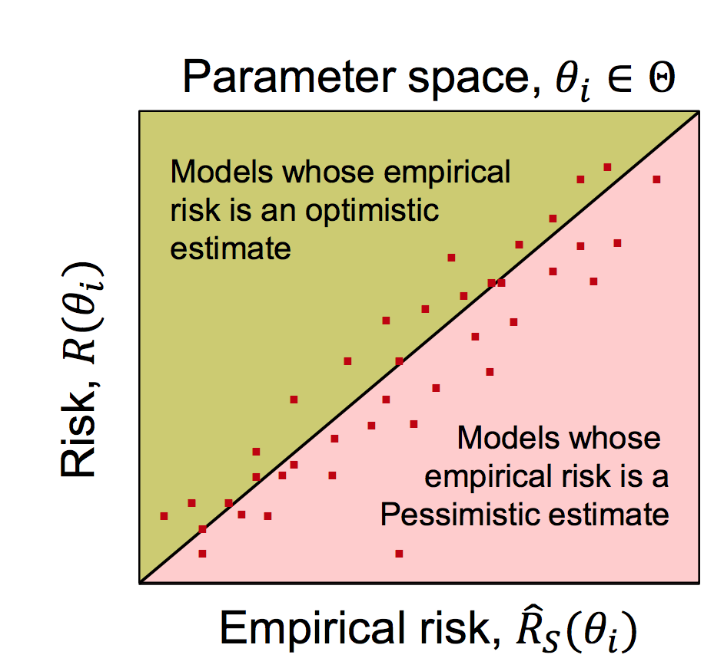
Source: University of Potsdam

Slide 55
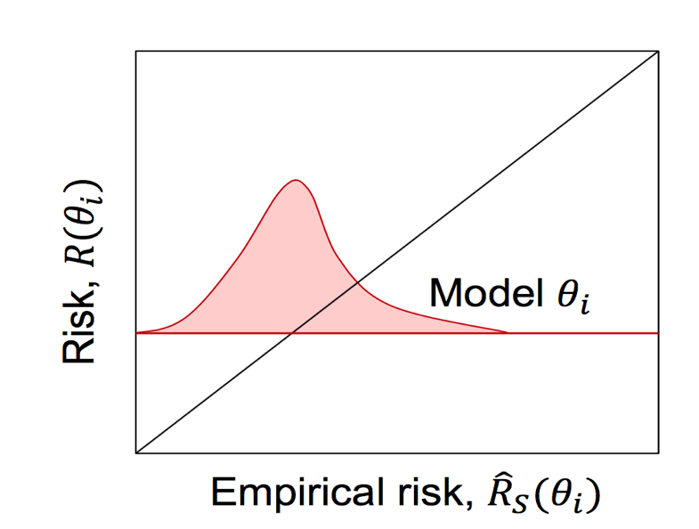
Source: University of Potsdam

Slide 56
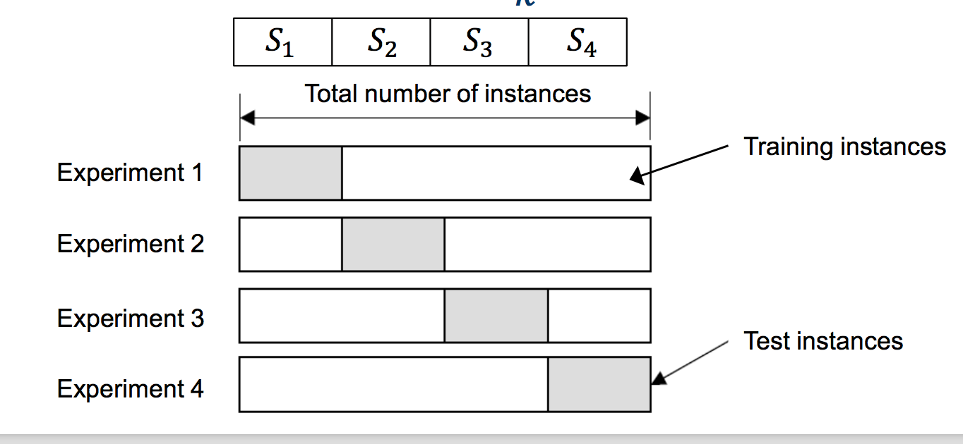
CV

Slide 57
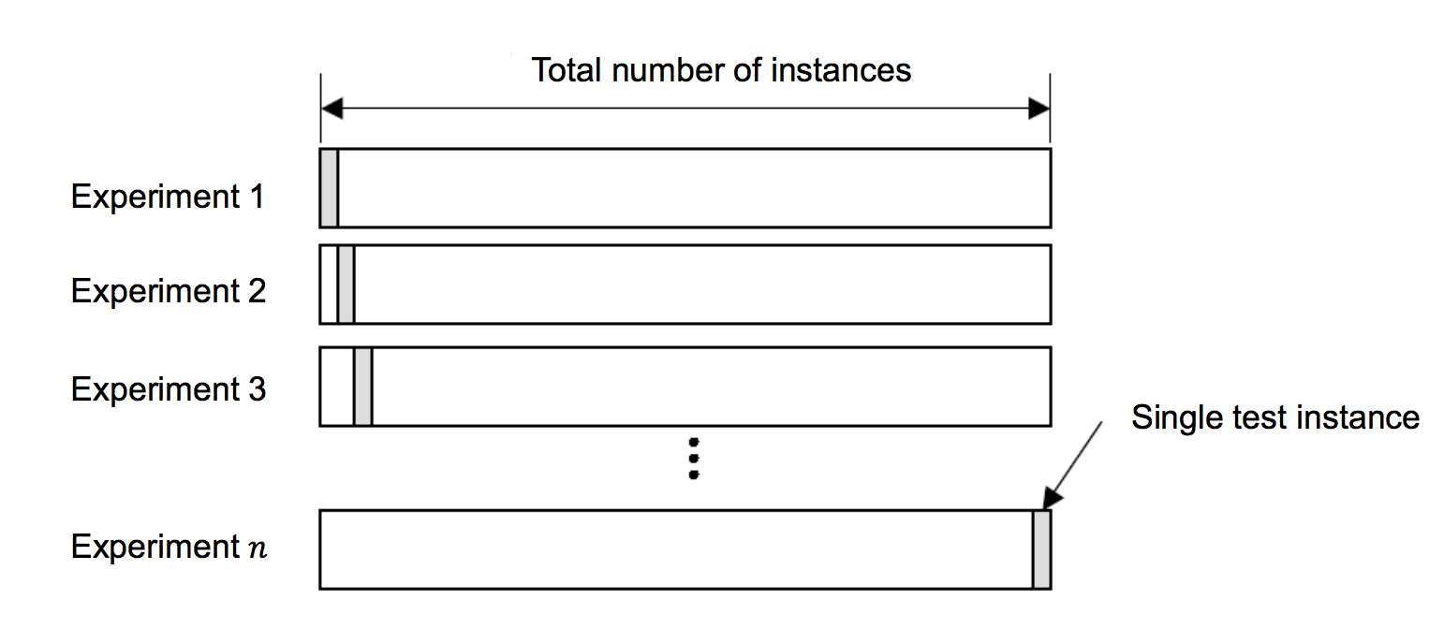
LOOCV

Slide 58
Nested CV
From Quora: http://bit.ly/2wvz2aZ

Slide 59
Messing up your experiments
Data split strategy is part of experiment.
Mainly care for:
Class distribution
Problem domain relevant issues such as time
”Validation and Test sets should model nature and nature is not accommodating." --- Data Scientist’s Proverbs
Notes:
Most common things to fuck up is:
(1) don’t care about class distribution (mainly on imbalanced data sets)
(2) do not care for time, e.g. model supposed to predict future but has past as test

